Slide 1

American International University - Bangladesh (AIUB)
TOPIC:ONLINE DOCTOR
COURSE: SOFTWARE ENGINEERING

Slide 2
Project submitted by
1. Hasan,Sajidul 18-38627-2 2. Sarker,Durjoy 18-38181-2
3. Bokhtiar,Rifat 18-38409-2
4.Ashtary,Turshin Ara 18-38593-2

Slide 3
Problem definition
The people of Panchagarh district do not have enough facilities for physical treatment . Only few hospitals and doctors are available there . In this current situation of the world where people are being affected by corona virus , they need proper treatments. Moreover sometimes at midnight people fall I'll but most of the time vehicles are unavailable .So getting treatments without going out people need an online doctor specially the village people who suffer a lot because of the long ways from village to town. To solve this problem, an online doctor facilities need to be developed .

Slide 4
Features
This online doctor will
have following features :
1. Simple log in process
2. Making profile of doctors
3. Three categories for calling a doctor
4. There will be a video calling option so that if there is no critical disease or there is any
corona cases the doctor can give suggestions on video call.
5. Providing current address of the patient so that the doctor can visit the patients for any
emergency .
6. Free doctors
7. Online payment

Slide 5
Project Proposal
Root cause of this problem : Being hospitalized or getting treatment has always been a huge problem in our country as we have less hospital and doctor as per as we need .Sometimes we do not have the time to check door to door of every hospital to get appointment for a doctor. If somehow we can reduce thus problem there will a huge chance to save a life . Nowadays our country is going through with such a pandemic where getting treatments has become one of the major problems. That is why we need to develop a system which can reduce such kind of problems.

Slide 6
Project objective :
Our goal will be to create a vast no. Of community where there will be all the facilities to give a person his/her proper health treatment about his physical condition. It merges with the resources we have in our medical ministry with the information
Technology field , whereas the programming of data processing systems evolved into standardized routines and packages of enterprise resource planning software. This linkage between medical accessories and human resources we have to be fully utilized.

Slide 7
The Solutions :
In this situation, many hospitals are closed, that’s why peoples are suffering day by day. We decided to solve this problem through online. People can use this software to contact with doctors immediately. This software also will be easily useable.
In this software, doctors can register there profile and set how much fee he/she want. Patient can easily log in and request for the doctors and then the doctor will accept his/her request and send the time for visit.
In this software there will be 3 categories for the patients:
1) Normal sickness,
2) Critical Situation,
3) Call in a doctor.

Slide 8
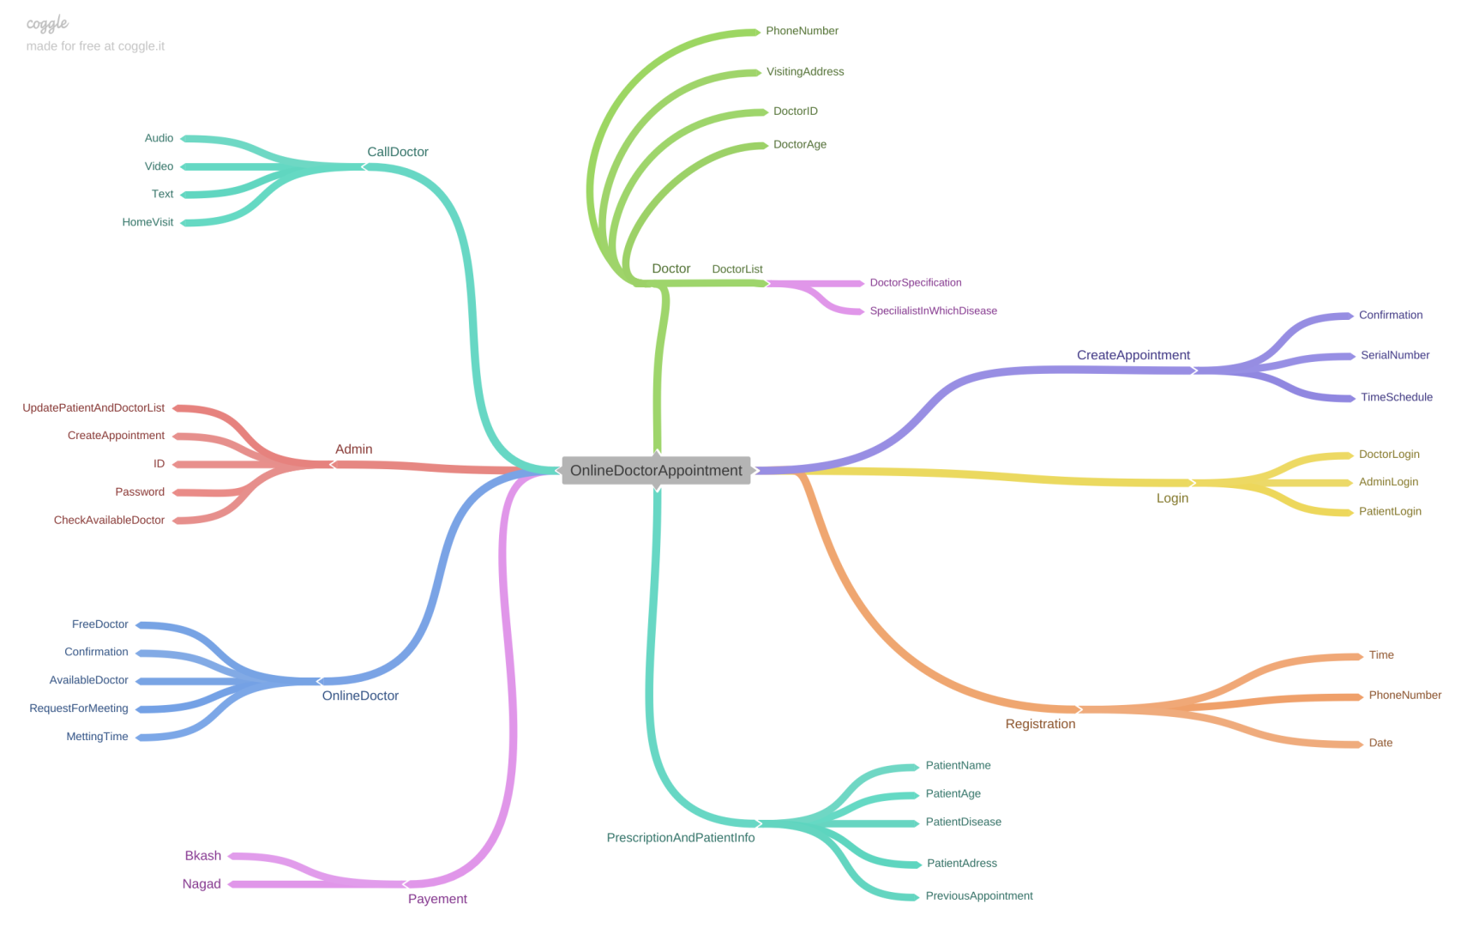
Mind Mapping

Slide 9
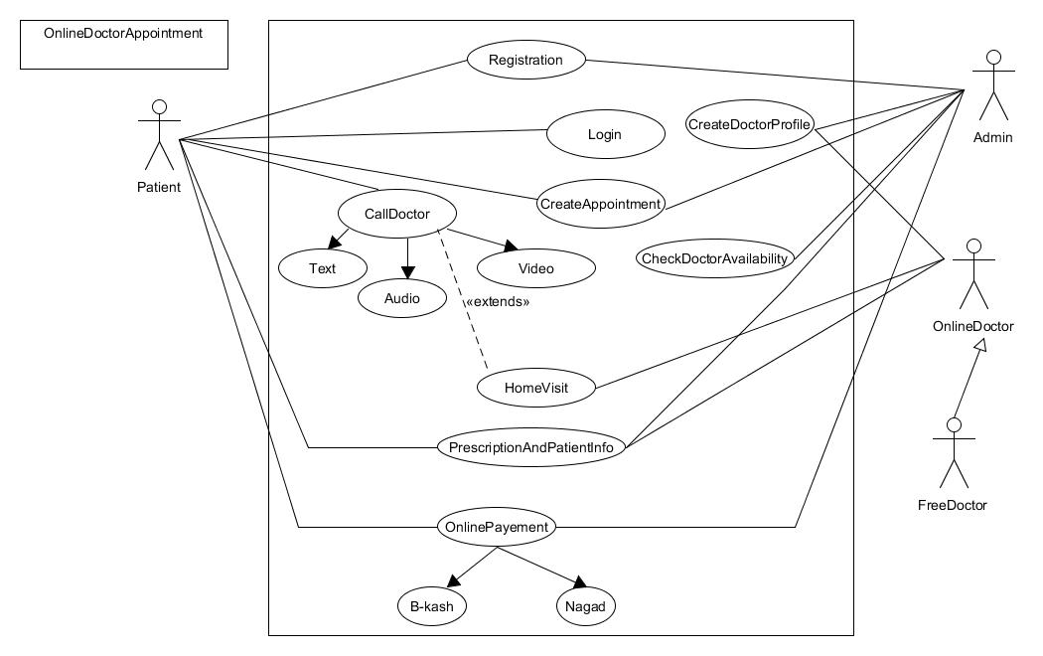
Use Case

Slide 10
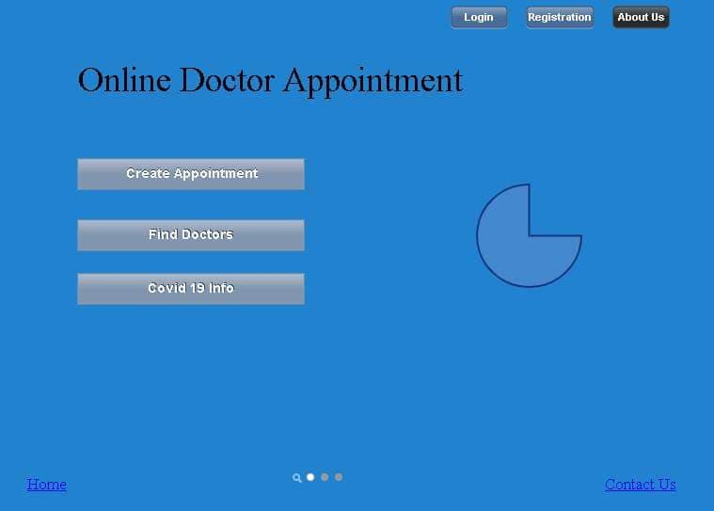

Slide 11
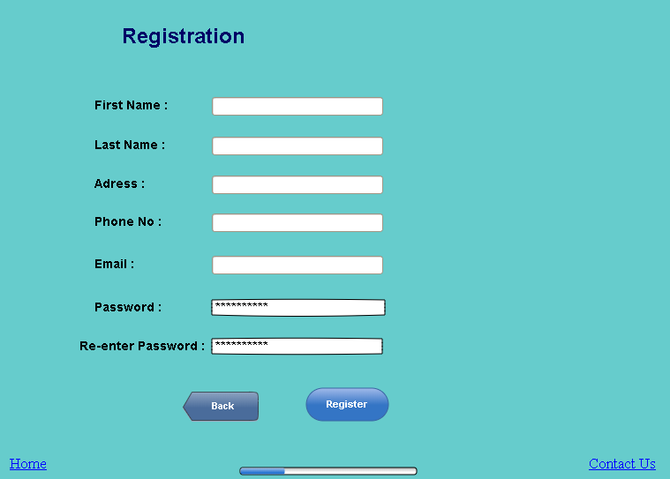

Slide 12
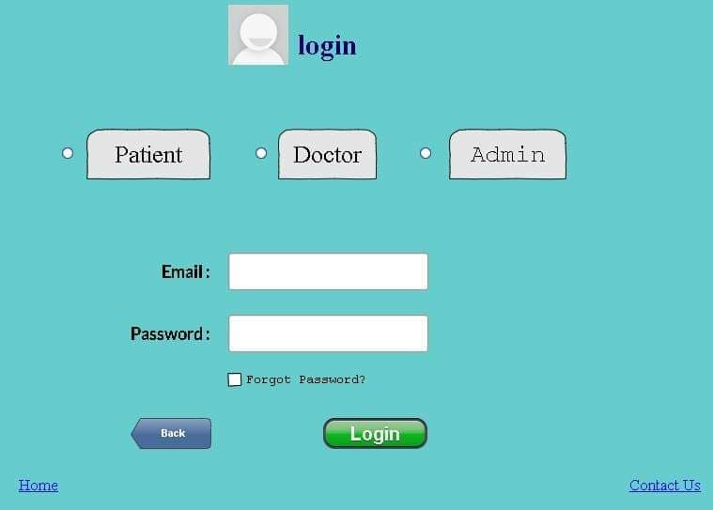

Slide 13
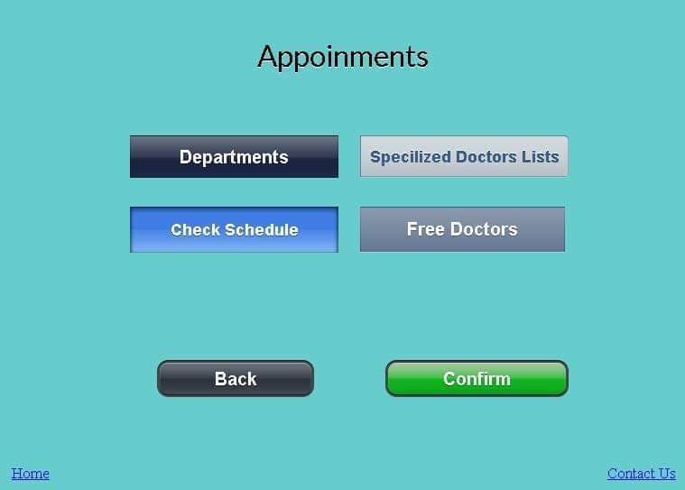

Slide 14
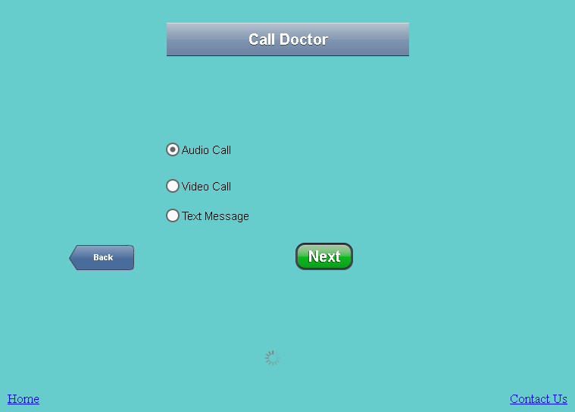

Slide 15
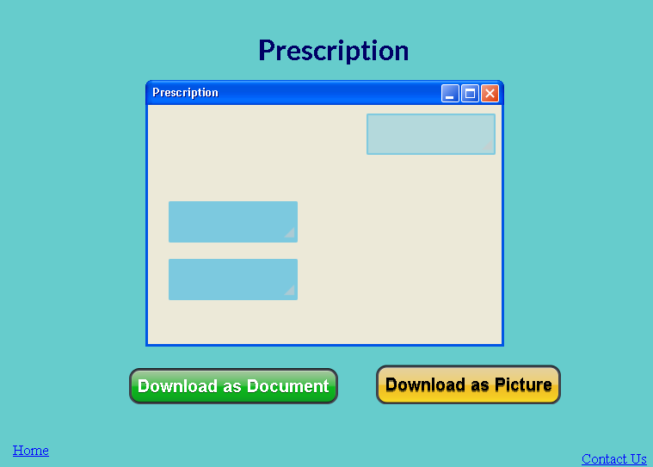

Slide 16
